Slide 1



Department of Computer Science and Engineering
Neural Mark: Harnessing Convolutional Neural Networks for Robust Digital Image Watermarking
MOHANRAM A 211420104165
PRAKASH J 211420104198
KAMESH S 211420104120
Dr T A Mohanaprakash,
M.TECH., Ph.D.,
Dr. G.Senthil Kumar, M.C.A.,M.Phil.,M.B.A., M.E., Ph.D

Slide 2
Introduction
Introduction to Image Watermarking:
Definition: Image watermarking is the process of embedding hidden information, known as a watermark, into digital images to protect intellectual property rights and verify authenticity.
Importance: With the proliferation of digital media and online sharing platforms, image watermarking plays a crucial role in copyright protection, content authentication, and tamper detection.
Challenges in Traditional Watermarking Methods:
Manual Design: Traditional methods often involve manual design and parameter tuning of watermarking algorithms, which can be time-consuming and labor-intensive.
Limited Robustness: Handcrafted watermarking techniques may lack robustness against common image processing operations and attacks, compromising the integrity and security of watermarked images.

Slide 3
Abstract
In the era of digital communication and multimedia sharing, ensuring the integrity and ownership of digital content has become increasingly crucial. Digital watermarking techniques offer a solution by embedding imperceptible yet detectable signals within multimedia content, serving as a form of copyright protection and authentication. This research presents a novel approach to digital watermarking using convolutional neural networks (CNNs). The proposed technique involves the training of a CNN model to embed binary watermarks into images, followed by a demodulation and extraction process to recover the watermark from watermarked images. Evaluation metrics such as Bit Error Rate (BER), Mean Squared Error (MSE), and Peak Signal-to-Noise Ratio (PSNR) are employed to assess the fidelity of the watermarked images and the accuracy of watermark extraction. Comparative analysis with traditional watermarking techniques demonstrates the effectiveness of the CNN-based approach in terms of robustness and imperceptibility. The results showcase the potential of CNNs in enhancing the security and authenticity of digital content through watermarking, paving the way for advanced applications in digital rights management and content authentication.

Slide 4
Literature Survey
Author | year | Class | Mark | Embedding | Authentication information/method
Yiping[60] | 2006 | Fragile | Binary image | Wavelet | Secure watermarking for ROI of image authentication based on foreground extraction.
M.Hamad Hassan and S.A.M.Gilani[68] | 2006 | Fragile | T-channel | LSB | Watermark embedded into T channel randomly selected 2´2 blocks LSBs using 2D-Torus Auto-morphism.
Celik,G. Sharma and A.M. Tekalp[53] | 2006 | Fragile | Digital signature | LSB | Uses lossless G-LSB data embedding method.
Premaratne[61] | 2007 | Fragile | 2D barcode | Wavelet | One barcode is inserted into the low frequency component of the image and a second barcode watermark is embedded into low pass component of any wavelet decomposition at a specific level

Slide 5
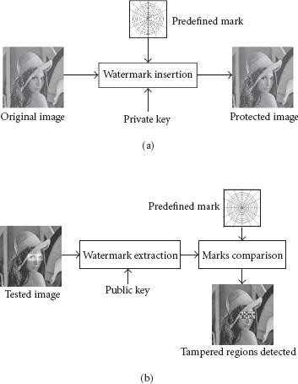
Principles of Watermark Schemes
Generic fragile watermark scheme
(a) Image security. (b) Authenticity verification

Slide 6
Existing System
HAAR WAVELET BASED
The watermarking model described implements a robust and efficient technique for embedding and extracting watermarks within digital images. Initially, the model loads and resizes both the original color image and the watermark image, ensuring compatibility in dimensions. Employing the Discrete Wavelet Transform (DWT) with the Haar wavelet, the model decomposes both images into four sub bands, facilitating efficient data representation. During watermarking, the model modifies the low-frequency LL sub-band of the host image by adding a scaled version of the watermark's LL sub-band. This process seamlessly integrates the watermark into the host image while preserving its visual integrity. Subsequently, watermark extraction involves subtracting the LL sub-band of the original image from that of the watermarked image, followed by scaling to isolate the embedded watermark.

Slide 7
Existing System
Evaluation metrics such as Peak Signal-to-Noise Ratio (PSNR) and Mean Squared Error (MSE) ensure the fidelity of the extracted watermark. Furthermore, post-processing steps, including conversion to grayscale and median filtering, enhance the clarity and robustness of the extracted watermark. This watermarking model presents a comprehensive approach to digital watermarking, offering both embedding and extraction functionalities with considerations for accuracy and resilience against common image processing operations.
Load and Resize Images
Apply DWT (Discrete Wavelet Transform)
Watermarking
Reconstruct Watermarked Image
Display and Save Watermarked Image

Slide 8
Aim and Objective
Aim:
The aim of the project "Neural Mark" is to develop and implement a robust digital image watermarking technique using Convolutional Neural Networks (CNNs). This aims to address the limitations of traditional watermarking methods by leveraging the power of deep learning algorithms to embed and extract watermarks efficiently while maintaining image quality and robustness against various attacks.
Objective:
Research and Analysis: Investigate existing digital image watermarking techniques and analyze CNN capabilities in image processing.
Model Development: Design and implement a CNN-based architecture optimized for watermark embedding and extraction.
Robustness Evaluation: Assess the technique's resistance against common image attacks while maintaining imperceptibility.
Performance Comparison: Compare CNN-based watermarking with traditional methods in terms of robustness and computational efficiency.

Slide 9
Proposed System
In the rapidly expanding digital landscape, the protection of intellectual property rights and the prevention of content piracy have become paramount concerns. Traditional watermarking techniques, while effective to a degree, often struggle to cope with the scale and diversity of digital media. To address these challenges, this paper proposes a novel approach leveraging Convolutional Neural Networks (CNNs) for automated noise modulation in image watermarking. Watermark embedding is a fundamental process in digital watermarking, whereby a unique identifier or signal, known as the watermark, is invisibly embedded into the host multimedia content to assert ownership, authenticate the content, or convey additional information. This process is crucial for protecting intellectual property rights, combating content piracy, and ensuring the integrity and authenticity of digital assets. The watermark embedding process involves several key steps to effectively conceal the watermark within the host multimedia content while minimizing perceptible distortion. First, the host content, such as images, videos, or audio files, is preprocessed to prepare it for watermark embedding.

Slide 10
Methodology Overview
Overview of the Proposed CNN-Based Approach:
The methodology consists of several key steps, including data preparation, CNN architecture design, training, testing, and evaluation.
Each step is crucial for developing and validating the CNN-based image watermarking technique.

Slide 11
Steps in the Methodology:
Data Preparation: Preprocessing of input images and generation of training data for CNN-based noise modulation.
CNN Architecture Design: Designing a suitable CNN architecture tailored for the task of noise modulation, considering factors such as network depth, layer configurations, and activation functions.
Training: Training the CNN model using the prepared training data and optimizing the model parameters to learn noise modulation patterns.
Testing: Evaluating the trained CNN model on separate test datasets to assess its performance in modulating noise onto host images.
Evaluation: Quantitative and qualitative evaluation of the CNN-based approach using standard watermarking metrics and visual inspection of watermarked images.
The methodology aims to develop a robust and effective CNN-based image watermarking technique through systematic experimentation and analysis.

Slide 12
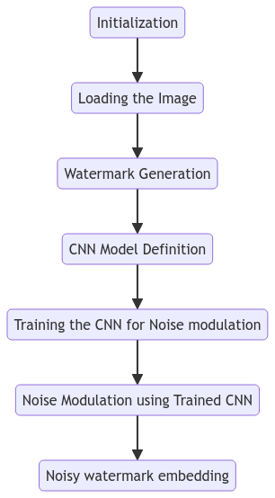


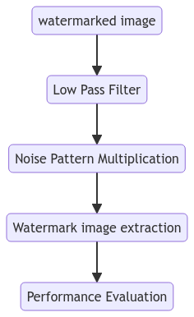


System Architecture

Slide 13
System Architecture
Convolutional Neural Network (CNN):
A CNN is a deep learning model widely used for various image processing tasks, including image classification, object detection, and segmentation.
Design Considerations:
Network Depth: Determine the number of layers in the CNN architecture, balancing model complexity and computational efficiency.
Layer Configurations: Specify the configuration of convolutional, pooling, normalization, and activation layers.
Activation Functions: Choose suitable activation functions, such as ReLU (Rectified Linear Unit), to introduce non-linearity and improve model capacity.

Slide 14
System Architecture
CNN Architecture:
Input Layer: Accept grayscale images as input.
Convolutional Layers: Extract features from input images through convolution operations.
Batch Normalization Layers: Normalize the activations of previous layers to stabilize training.
ReLU Activation Layers: Introduce non-linearity to the model.
Regression Output Layer: Output the noise-modulated image.
Architecture Optimization:
Experiment with different architectures and hyperparameters to find the optimal configuration for noise modulation in image watermarking.

Slide 15
Module Description
Encoding Algorithm: This module would include the algorithm used to embed the secret data within the video file. There are various techniques that can be used for this purpose, such as LSB (Least Significant Bit) embedding, Spread Spectrum, and Transform Domain Techniques. Decoding Algorithm: This module would include the algorithm used to extract the secret data from the video file. The decoding algorithm should be able to retrieve the hidden information with high accuracy, while avoiding false positives or negatives.
Security Module: This module would include security features such as encryption and decryption, password protection, and watermarking. It would ensure that the embedded data is only accessible to authorized parties and prevent unauthorized access or tampering.

Slide 16
Software / Hardware used
1.SOFTWARE REQUIREMENTS
Operating System : Windows
Tool : Matlab 2023
2. HARDWARE REQUIREMENTS:
Processor : I5
Hard disk : minimum 500 GB
RAM : minimum 8 GB

Slide 17
Conclusion
In conclusion, the comparison of evaluation metrics for watermarking and extraction techniques reveals distinct performance disparities among the proposed Convolutional Neural Network (CNN) method and three alternative techniques: HAAR Wavelet, Discrete Cosine Transform (DCT), and Discrete Wavelet Transform (DWT). The proposed CNN method outperforms the other techniques across all evaluated metrics. Specifically, it achieves the highest Peak Signal-toNoise Ratio (PSNR), lowest Bit Error Rate (BER), and lowest Mean Squared Error (MSE) values compared to HAAR Wavelet, DCT, and DWT methods. This indicates that the CNN-based approach offers superior accuracy in watermark extraction and reconstruction tasks.

Slide 18
Future Scope
HAAR Wavelet, DCT, and DWT techniques, while traditional and widely used, exhibit comparatively lower performance in terms of PSNR, BER, and MSE. These methods may still find utility in certain applications, but the results suggest that the proposed CNN method offers significant advancements in watermarking and extraction tasks, potentially leading to improved robustness and fidelity in digital content protection and authentication. Overall, the findings underscore the efficacy of CNN-based approaches in watermarking and extraction tasks and suggest avenues for further research and development in leveraging deep learning techniques for enhanced multimedia security and copyright protection.

Slide 19
Reference Paper
[1] S. D. Lin and C.-F. Chen, “A robust DCT-based watermarking for copyright protection,” IEEE Trans. Consum. Electron., vol. 46, no. 3, pp. 415–421, 2000.
[2] F. Guerrini, M. Okuda, N. Adami, and R. Leonardi, “High dynamic range image watermarking robust against tone-mapping operators,” IEEE Trans. Inf. Forensics Secur., vol. 6, no. 2, pp. 283–295, 2011.
[3] M. A. Akhaee, S. M. E. Sahraeian, and C. Jin, “Blind image watermarking using a sample projection approach,” IEEE Trans. Inf. Forensics Secur., vol. 6, no. 3, pp. 883–893, 2011.
[4] F. Zhang, W. Liu, W. Lin, and K. N. Ngan, “Spread spectrum image watermarking based on perceptual quality metric,” IEEE Trans. Image Process., vol. 20, no. 11, pp. 3207–3218, 2011.
[5] M. Barni, F. Bartolini, and A. Piva, “Improved wavelet-based watermarking through pixel-wise masking,” IEEE Trans. image Process., vol. 10, no. 5, pp.783– 791, 2001.

Slide 20
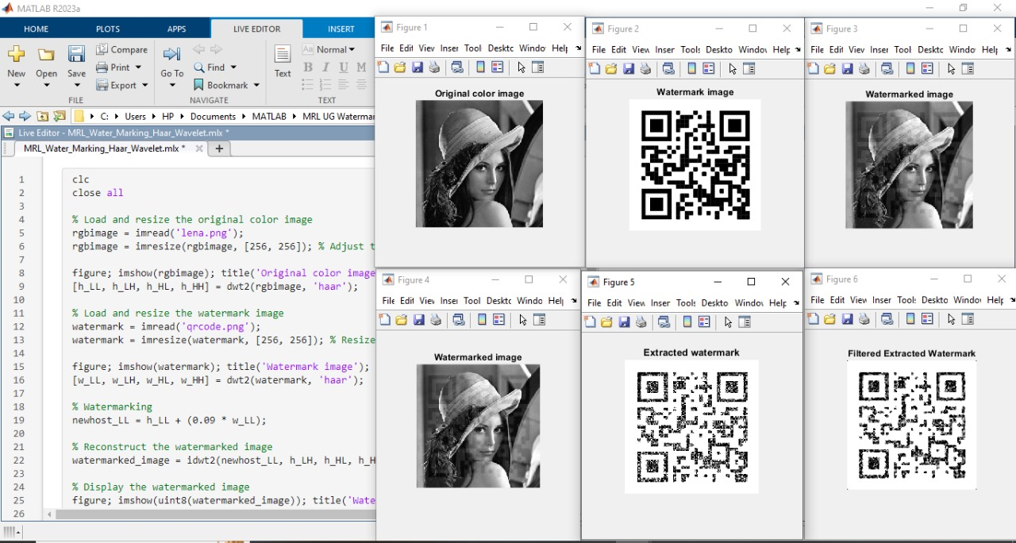
SCREENSHOTS

Slide 21
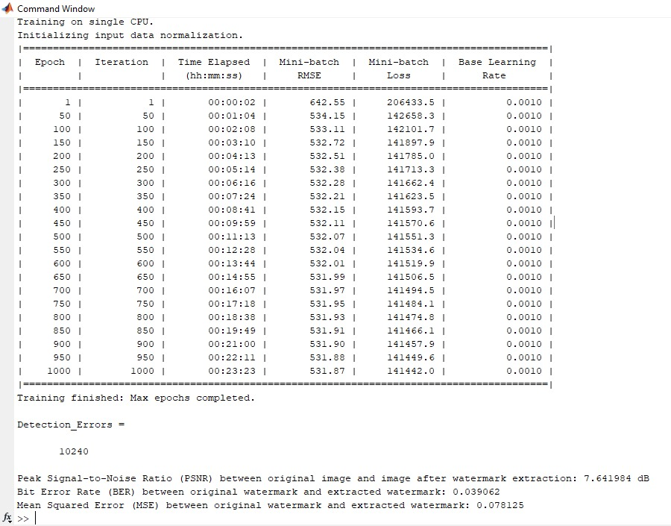
SCREENSHOTS

Slide 22
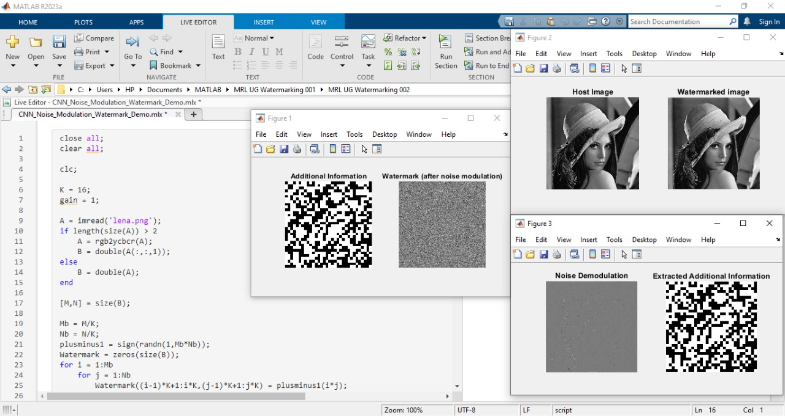
SCREENSHOTS

Slide 23
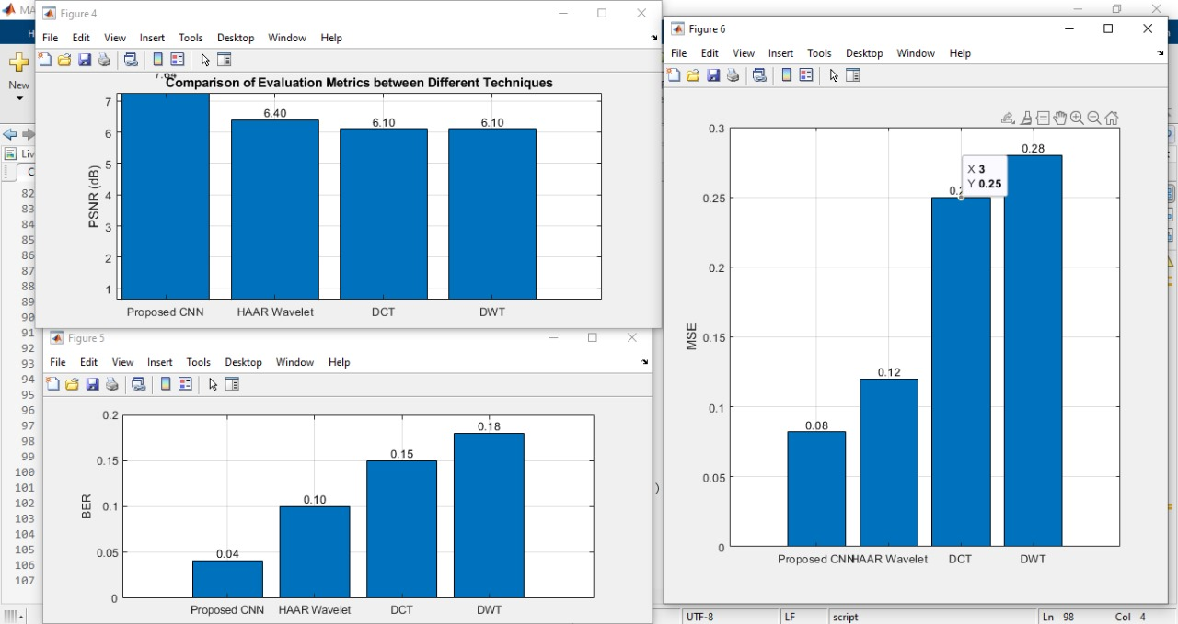
SCREENSHOTS

